Slide 1
Parallel Computing
Ekkapot Charoenwanit
Software Systems Engineering
TGGS
KMUTNB

Slide 2
Lecture 13:
Distributed-Memory Programming with MPI
Blocking Collective Communication

Slide 3
MPI: Collective Communication
A collective operation involves all ranks in a given communicator:
All the ranks in the communicator work together to distribute or gather a set of one or multiple values.
All ranks must call the same MPI operations to succeed.
There must be one call per MPI rank, i.e., not per thread.

Slide 4







MPI: Barrier
The barrier operation serves as an explicit synchronization operation in MPI.
C
MPI_Barrier(MPI_Comm comm)
Rank 0
MPI_Barrier
$$t_{s,0}$$
$$t_{E,0}$$
Rank 1
MPI_Barrier
$$t_{s,1}$$
$$t_{E,1}$$
Rank 2
MPI_Barrier
$$t_{s,2}$$
$$t_{s,2}$$
$${max⁡(t}_{s,0}, t_{s,1},t_{s,2})<min⁡(t_{E,0},t_{E,1},t_{E,2})$$

Slide 5
MPI: Barrier
Barriers are useful for benchmarking:
They can be used to synchronize before taking time measurements.
Barrier
Rank 0
MPI_Init
Barrier
Parallel Work
Rank 1
MPI_Init
Barrier
Rank 2
MPI_Init
Barrier
Elapsed time as measured by Rank 0

Slide 6
MPI: Barrier
Barriers are useful for benchmarking:
They can be used to synchronize before taking time measurements.
Without barriers, there is huge discrepancy between the time measurement and the parallel time of the parallel work.
Elapsed time as measured by Rank 0
Rank 0
MPI_Init
Parallel Work
Rank 1
MPI_Init
Rank 2
MPI_Init

Slide 7
MPI: Broadcast
The broadcast operation is a one-to-many collective operation:
It distributes data from one rank to all the other ranks in the same communicator.
data : send buffer on the root rank
receiver buffer on the other ranks
count : the number of data elements
type : the type of the elements
root : source rank ; all ranks must specify the same value
comm : communicator
C
MPI_Broadcast(void * data, int count, MPI_Datatype type, int root, MPI_Comm comm)

Slide 8
MPI: Broadcast
On the root rank, the data buffer acts as an input argument.
On all ranks, but the root rank, the data buffer acts as an output argument.
The type signatures must match across all ranks in the given communicator.
C
MPI_Broadcast(void * data, int count, MPI_Datatype type, int root, MPI_Comm comm)

Slide 9





MPI: Broadcast
Data
Data
$$A_{0}$$
Broadcast
$$A_{0}$$
$$A_{0}$$
Ranks
Ranks
$$A_{0}$$
$$A_{0}$$

Slide 10
MPI: Broadcast
Correct Usage: all ranks must call MPI_Bcast.
C
int data;
If(rank==0)//rank 0 is the root
data = read_input_from_user();
MP_Bcast( &data , 1 , MPI_INT , 0 , MPI_COMM_WORLD );

Slide 11
MPI: Broadcast
Wrong Usage: only the root calls MPI_Bcast.
This leads to deadlock !
C
int data;
If(rank==0){//rank 0 is the root
data = read_input_from_user();
MP_Bcast( &data , 1 , MPI_INT , 0 , MPI_COMM_WORLD );
}

Slide 12
MPI: Broadcast
Naïve Implementation:
C
void broadcast(void * data , int count , MPI_Datatype type , int root , MPI_Comm comm ){
int rank , size;
MPI_Comm_rank(MPI_COMM_WORLD,&rank);
MPI_Comm_size(MPI_COMM_WORLD,&size);
if(rank==root){
for(int i=0;i<size;i++){
if(i!=root){
MPI_Send( data , count , type , i , TAG_BCAST , comm );
}
}
}else{
MPI_Receive( data , count , type , root , TAG_BCAST , comm , MPI_STATUS_IGNORE );
}
}

Slide 13
MPI: Scatter
The scatter operation is a one-to-many collective operation:
It distributes chunks of data from one rank to all ranks in the same communicator.
C
MPI_Scatter(void * sendbuf, int sendcount, MPI_Datatype sendtype,
void* recvbuf, int recvcount, MPI_Datatype recvtype,
int root, MPI_Comm comm)
These arguments matter only on the root rank

Slide 14
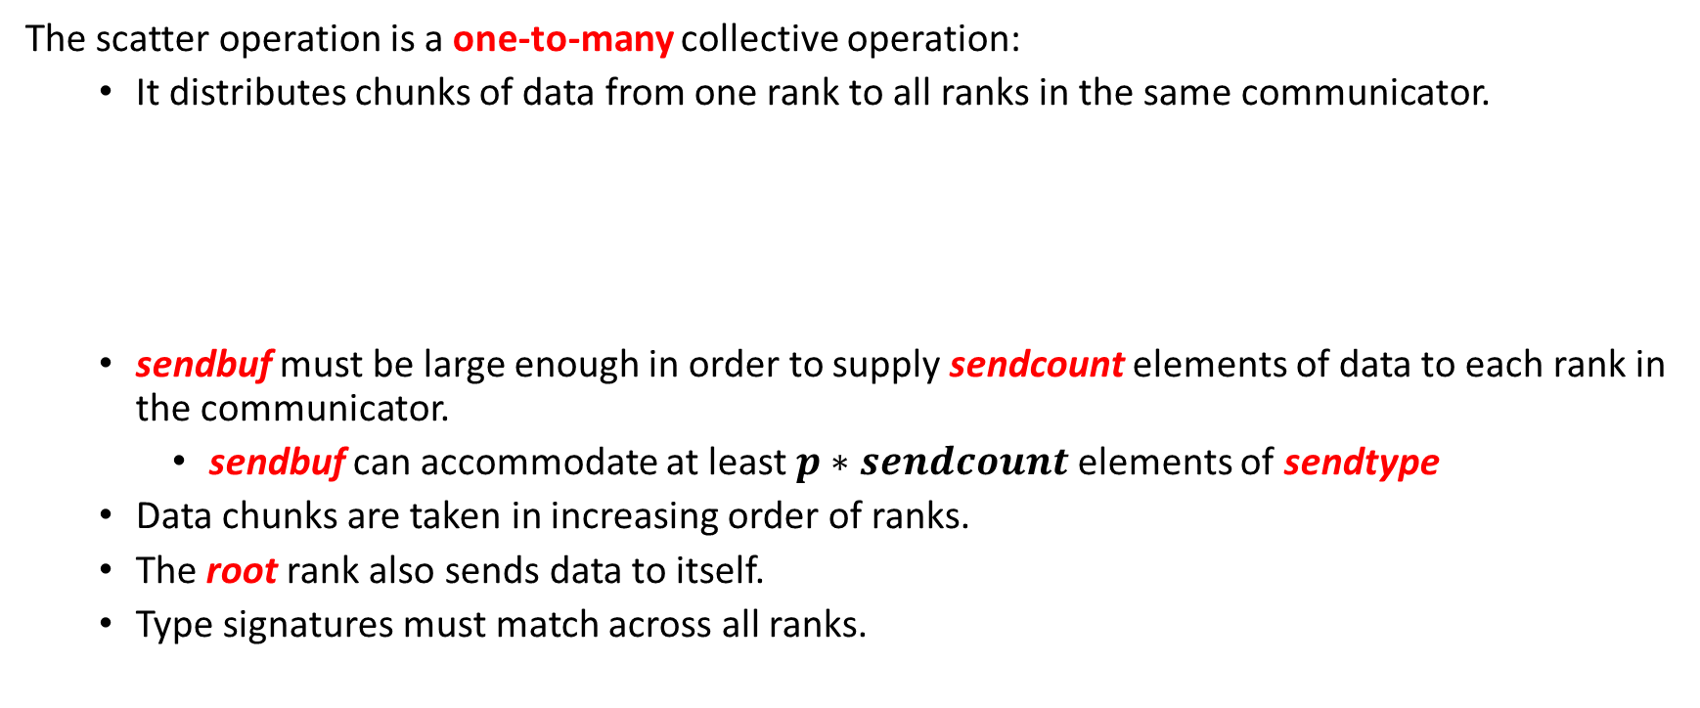
MPI: Scatter
The scatter operation is a one-to-many collective operation:
It distributes chunks of data from one rank to all ranks in the same communicator.
sendbuf must be large enough in order to supply sendcount elements of data to each rank in the communicator.
sendbuf can accommodate at least $p∗sendcount$elements of sendtype
Data chunks are taken in increasing order of ranks.
The root rank also sends data to itself.
Type signatures must match across all ranks.
C
MPI_Scatter(void * sendbuf, int sendcount, MPI_Datatype sendtype,
void* recvbuf, int recvcount, MPI_Datatype recvtype,
int root, MPI_Comm comm)

Slide 15







MPI: Scatter
sendbuf
recvbuf
$$A_{0}$$
$$A_{1}$$
$$A_{2}$$
$$A_{3}$$
Scatter
$$A_{0}$$
$$A_{1}$$
Ranks
Ranks
$$A_{2}$$
$$A_{3}$$

Slide 16
MPI: Scatter
C
sendbuf is only accessed on the root rank.
recvbuf is accessed and written into on all ranks.
Usage:
MPI_Scatter(void * sendbuf, int sendcount, MPI_Datatype sendtype,
void* recvbuf, int recvcount, MPI_Datatype recvtype,
int root, MPI_Comm comm)
Each rank receives 2 elements into recvbuff.
The root sends 2 elements from sendbuf to each rank.
C
int bigdata[8]; //2 x 4 elements
int localdata[2];
MPI_Scatter( bigdata , 2 , MPI_INT , localdata, 2 , MPI_INT , 0 , MPI_COMM_WORLD );

Slide 17
MPI: Gather
The gather operation is a many-to-one collective operation:
It distributes chunks of data from all ranks to one rank, i.e., the root.
C
MPI_Gather(void * sendbuf, int sendcount, MPI_Datatype sendtype,
void* recvbuf, int recvcount, MPI_Datatype recvtype,
int root, MPI_Comm comm)
These arguments matter only on the root rank

Slide 18
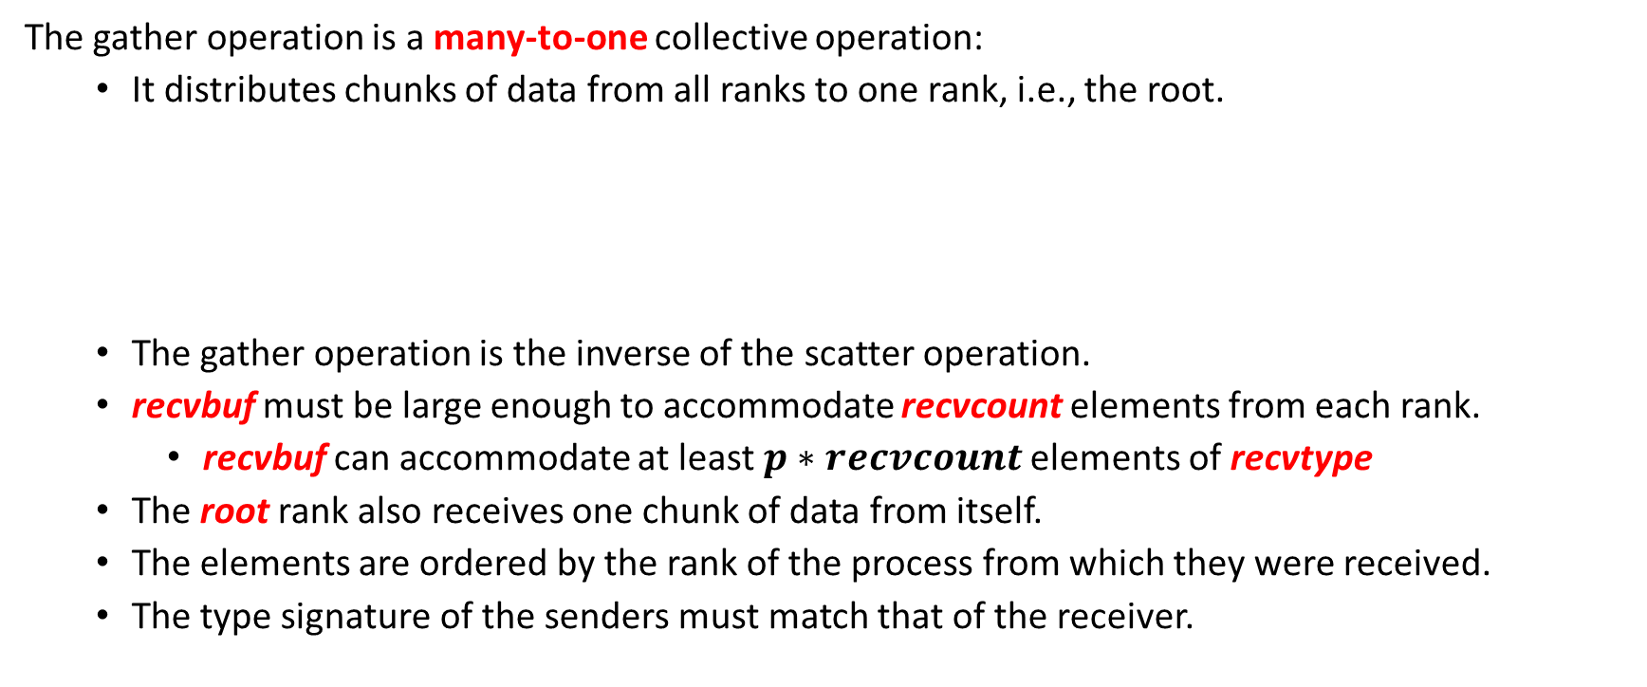
MPI: Gather
The gather operation is a many-to-one collective operation:
It distributes chunks of data from all ranks to one rank, i.e., the root.
The gather operation is the inverse of the scatter operation.
recvbuf must be large enough to accommodate recvcount elements from each rank.
recvbuf can accommodate at least $p∗recvcount$elements of recvtype
The root rank also receives one chunk of data from itself.
The elements are ordered by the rank of the process from which they were received.
The type signature of the senders must match that of the receiver.
C
MPI_Gather(void * sendbuf, int sendcount, MPI_Datatype sendtype,
void* recvbuf, int recvcount, MPI_Datatype recvtype,
int root, MPI_Comm comm)

Slide 19








MPI: Gather
sendbuf
recvbuf
Gather
$$A_{0}$$
$$B_{0}$$
$$C_{0}$$
$$D_{0}$$
$$A_{0}$$
$$B_{0}$$
Ranks
Ranks
$$C_{0}$$
$$D_{0}$$

Slide 20
MPI: All-Gather
The all-gather operation is a many-to-many collective operation:
It collects chunks of data from all ranks to all ranks.
There is no root rank as all ranks receive a copy of the gathered data.
The function signature is almost identical to that of MPI_Gather except that there is no root.
Each rank receives one chunk of data from itself.
Data chunks are stored in increasing order of the sender’s rank.
Type signatures match across all ranks.
Logically, it is equivalent to MPI_Gather followed by MPI_Bcast:
The actual implementation can potentially outperform such a straightforward implementation through some clever tricks.
C
MPI_Allgather(void * sendbuf, int sendcount, MPI_Datatype sendtype,
void* recvbuf, int recvcount, MPI_Datatype recvtype,
MPI_Comm comm)

Slide 21












MPI: All-Gather
sendbuf
recvbuf
Gather to All
$$A_{0}$$
$$B_{0}$$
$$C_{0}$$
$$D_{0}$$
$$A_{0}$$
$$B_{0}$$
$$A_{0}$$
$$B_{0}$$
$$C_{0}$$
$$D_{0}$$
Ranks
Ranks
$$C_{0}$$
$$A_{0}$$
$$B_{0}$$
$$C_{0}$$
$$D_{0}$$
$$D_{0}$$
$$A_{0}$$
$$B_{0}$$
$$C_{0}$$
$$D_{0}$$

Slide 22
MPI: All-to-All
The all-to-all operation is a many-to-many collective operation:
It is a collective operation that combines the scatter and the gather operation.
Each rank distributes its sendbuf to every rank in the communicator including itself.
Data chunks are read in increasing order of the receiver’s rank.
Data chunks are stored in increasing order of the sender’s rank.
Equivalent to MPI_Scatter + MPI_Gather
C
MPI_Alltoall(void * sendbuf, int sendcount, MPI_Datatype sendtype,
void* recvbuf, int recvcount, MPI_Datatype recvtype,
MPI_Comm comm)

Slide 23
































MPI: All-to-All
sendbuf
recvbuf
$$A_{0}$$
$$A_{1}$$
$$A_{2}$$
$$A_{3}$$
All to All
$$A_{0}$$
$$B_{0}$$
$$C_{0}$$
$$D_{0}$$
$$B_{0}$$
$$B_{1}$$
$$B_{2}$$
$$B_{3}$$
$$A_{1}$$
$$B_{1}$$
$$C_{1}$$
$$D_{1}$$
Ranks
Ranks
$$C_{0}$$
$$C_{1}$$
$$C_{2}$$
$$C_{3}$$
$$A_{2}$$
$$B_{2}$$
$$C_{2}$$
$$D_{2}$$
$$D_{0}$$
$$D_{1}$$
$$D_{2}$$
$$D_{3}$$
$$A_{3}$$
$$B_{3}$$
$$C_{3}$$
$$D_{3}$$

Slide 24
MPI: Reduce
The reduce operation is a many-to-one collective operation:
It performs an arithmetic reduction on the gathered data.
sbuf : data to be reduced
rbuf : location of the result (it matters only at the root rank)
count : the number of elements per rank
type : data type to be reduced
op : reduction operation handle
root : the root rank that performs the reduction operation on the gathered data
comm : the communicator
C
MPI_Reduce(void * sbuf, void * rbuf, int count,
MPI_Datatype type, MPI_Op op, int root , MPI_Comm comm)

Slide 25
MPI: Reduce
MPI_Op. | Result Value
MPI_MAX | Maximum Value
MPI_MIN | Minimum Value
MPI_SUM | Sum of all values
MPI_PROD | Product of all values
MPI_LAND | Logical AND of all values
MPI_BAND | Bitwise AND of all values
MPI_LOR | Logical OR of all values
… | …
All the predefined reduction operations are associative and commutative.
Pay attention to non-commutative effects on floats.

Slide 26







MPI: Reduce
$$rbuf\left[i\right]= sbuf_{0}\left[i\right]⊕sbuf_{1}\left[i\right]⊕sbuf_{2}\left[i\right]…⊕sbuf_{p−1}[i]$$
$$sbuf_{0}[ ]$$
1
2
3
4
5
6
$$sbuf_{1}[ ]$$
10
20
30
40
50
60
$$⊕ =MPI_SUM$$
$$sbuf_{2}[ ]$$
10
20
30
40
50
60
$$sbuf_{3}[ ]$$
100
200
300
400
500
600
r$buf[ ]$
111
222
333
444
555
666

Slide 27
MPI: All-Reduce
The all-reduce operation is a many-to-many collective operation:
The reduction result is available on all ranks in the given communicator.
It is logically equivalent to MPI_Reduce followed by MPI_Bcast using the same root rank.
C
MPI_Allreduce(void * sbuf, void * rbuf, int count,
MPI_Datatype type, MPI_Op op, MPI_Comm comm)

Slide 28
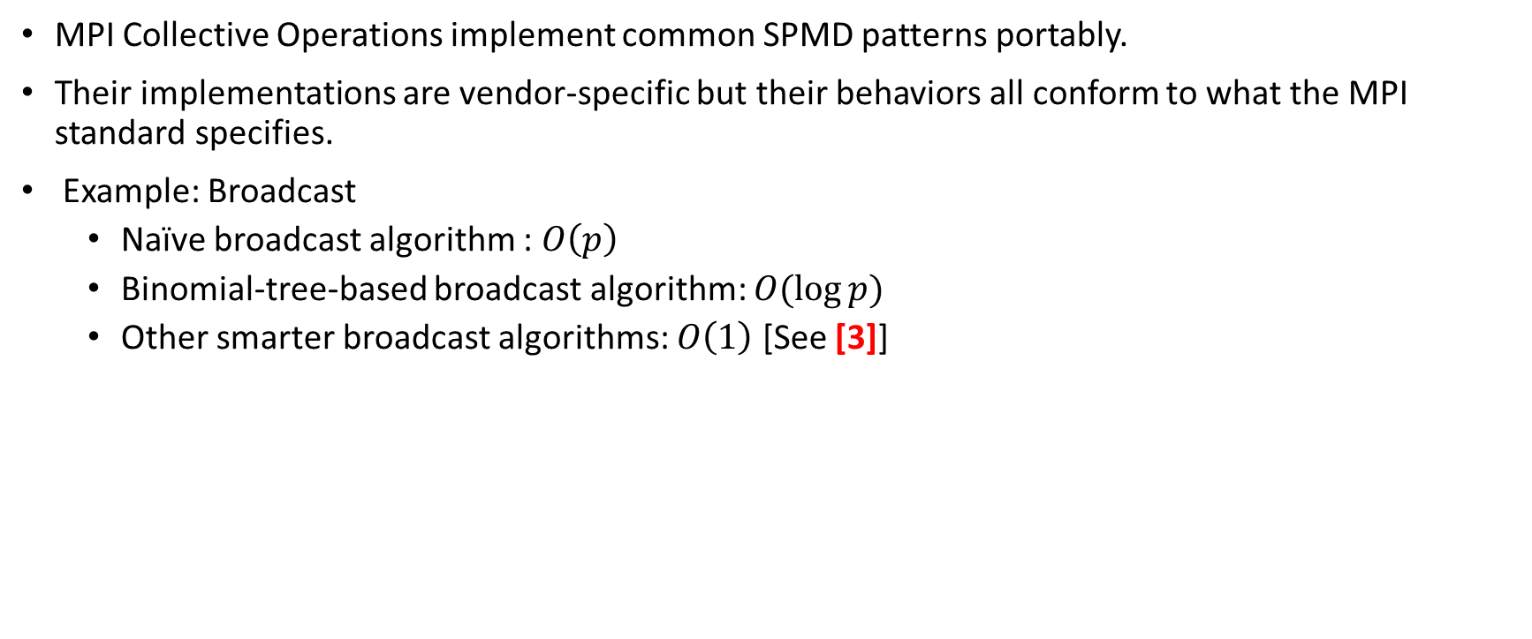
MPI: Advantages of Collective Operations
MPI Collective Operations implement common SPMD patterns portably.
Their implementations are vendor-specific but their behaviors all conform to what the MPI standard specifies.
Example: Broadcast
Naïve broadcast algorithm : $O\left(p\right)$
Binomial-tree-based broadcast algorithm: $O(\log{p)}$
Other smarter broadcast algorithms: $O\left(1\right)$ [See [3]]

Slide 29
MPI: Summary
All ranks in the communicator must call the collective operation.
Be careful with the number of elements and data type of data on the sender and the receiver end.
The order of collective calls must be the same across all ranks.
MPI_Barrier is the only explicit synchronization collective in MPI.
Some may synchronize implicitly, e.g. MPI_Alltoall
Communication paradigms do not interfere with one another.
Collective communication does not interfere with point-to-point communication on the same communicator.

Slide 30
References
[1] William Gropp, Ewing Lusk, and Anthony Skjellum. 2014. Using MPI: Portable Parallel Programming with the Message-Passing Interface. The MIT Press.
[2] Marc-Andre Hermanns. 2021. MPI in Small Bites. PPCES 2021.
[3] T. Hoefler, C. Siebert and W. Rehm, "A practically constant-time MPI Broadcast Algorithm for large-scale InfiniBand Clusters with Multicast," 2007 IEEE International Parallel and Distributed Processing Symposium, 2007, pp. 1-8, doi: 10.1109/IPDPS.2007.370475.

